Slide 1
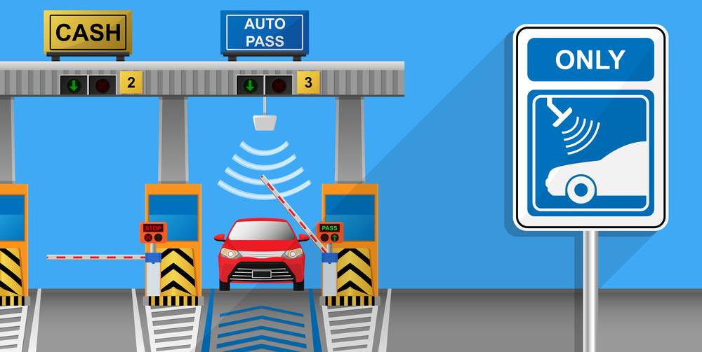
- Rakshit Kumar

Slide 2
Introduction:
What is Fastag?
Operated by the National Highway Authority of India, FASTag is an electronic system used for the collection of tolls on national and state highways.
In other words, FASTags are rechargeable RFID passive tags for toll collection that do not have any expiry date, and hence, can be used as long as they are not tampered with and are readable at the toll plazas.

Slide 3
How does it work?
Simply put, these are prepaid rechargeable tags that do not have an expiry date and can be used to collect tolls as long they are readable and not damaged or tampered with.
The Government has instructed vehicle owners to get FASTag enabled in their vehicles compulsorily from 15th February 2021, so the vehicles will no longer be required to queue up at toll gates as the amount can be deducted from the bank or prepaid account of the vehicle owner. This is done by making use of radio frequency identification (RFID) technology that uses the FASTag present on the windscreen of vehicles and toll is collected electronically.

Slide 4
Fastag Fraud Detection Model
The Fastag Fraud Detection model leverages machine learning techniques to identify fraudulent toll transactions in real-time.
By analyzing transaction data, vehicle information, and other relevant features, the model classifies transactions as fraudulent or non-fraudulent.
Key processes include data preprocessing, feature selection, model training using algorithms like Random Forest, and performance evaluation through metrics such as accuracy, precision, recall, and AUC-ROC.
This model aims to minimize financial losses and enhance the security of digital toll systems by effectively flagging suspicious activities.

Slide 5
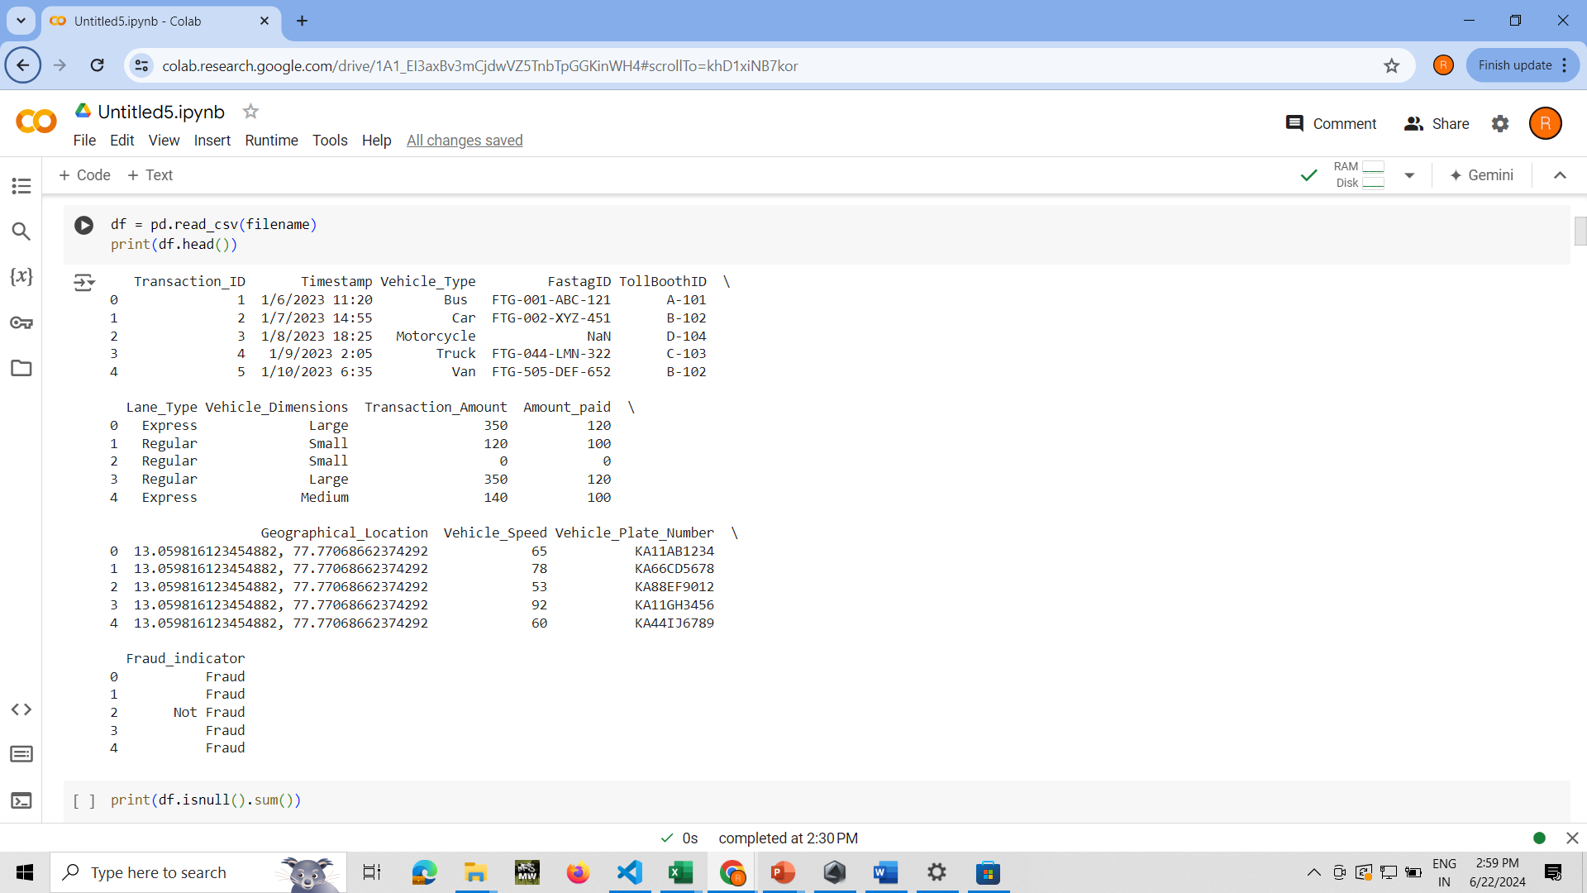
Working:
Firstly we upload the data using ‘uploaded = files.upload()’
After uploading we make the terminal read the data and this is how the output would like:

Slide 6
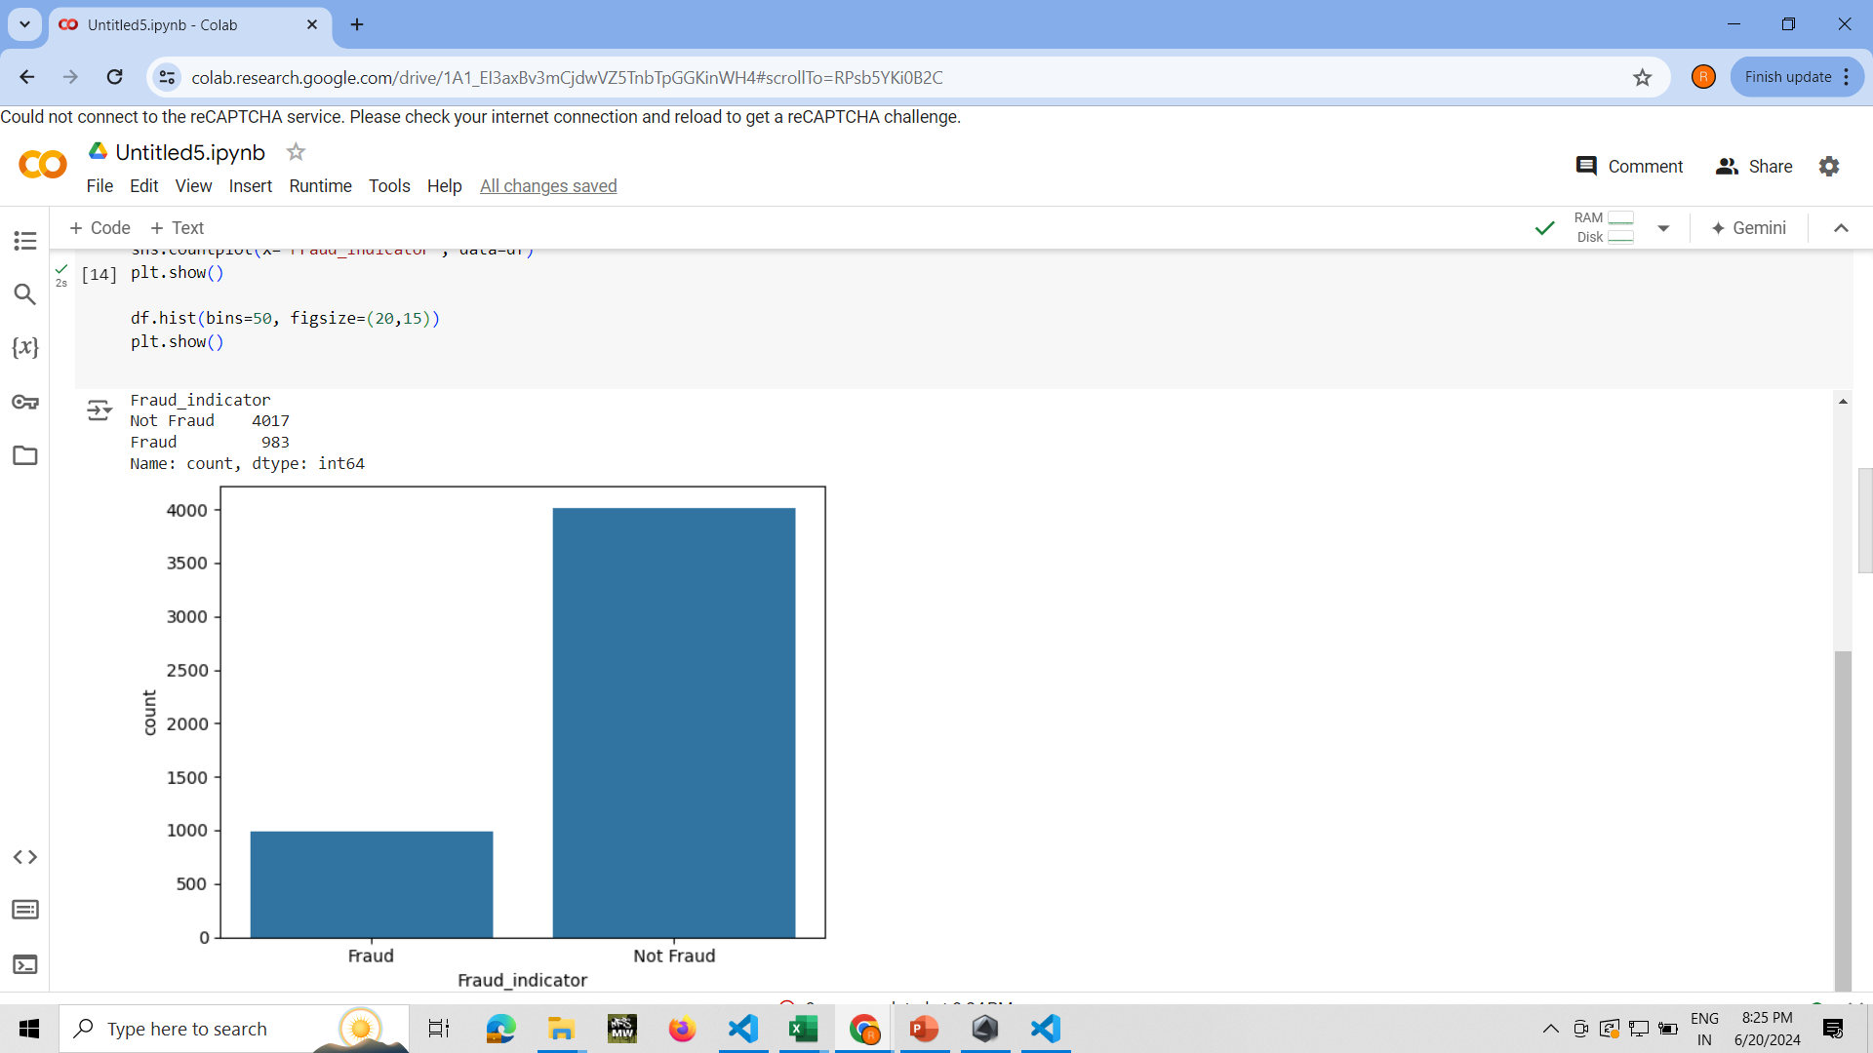
Now we plot the histogram for the data

Slide 7
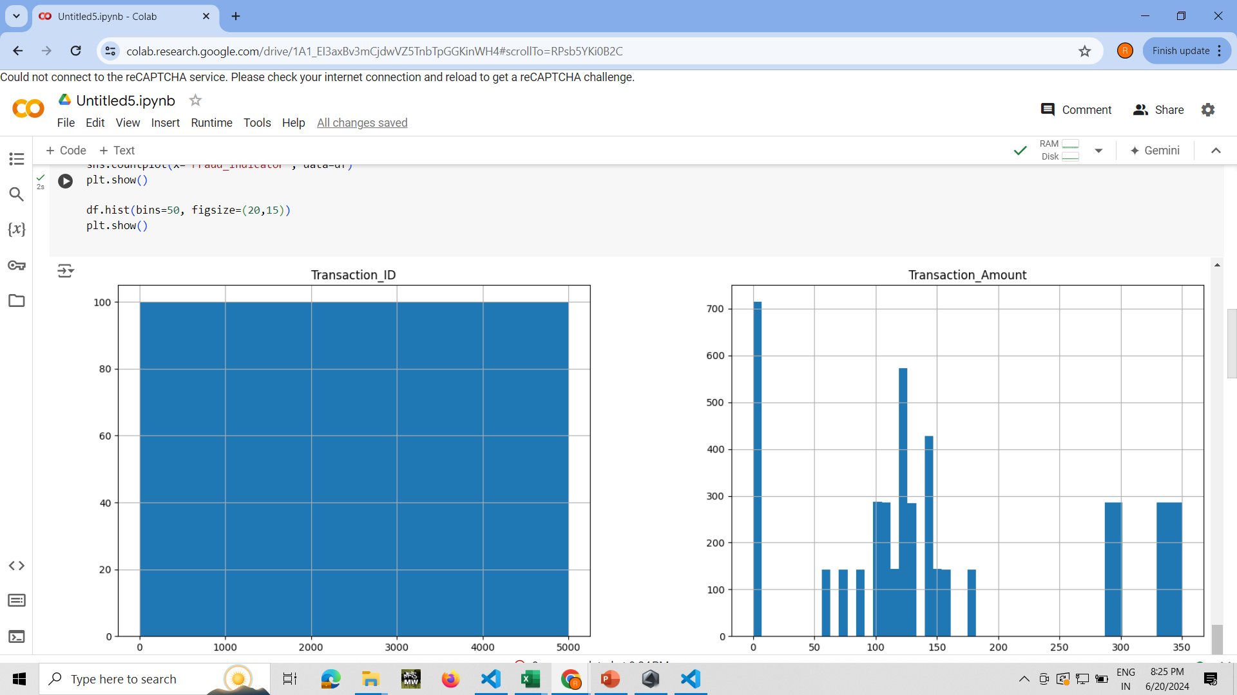

Slide 8
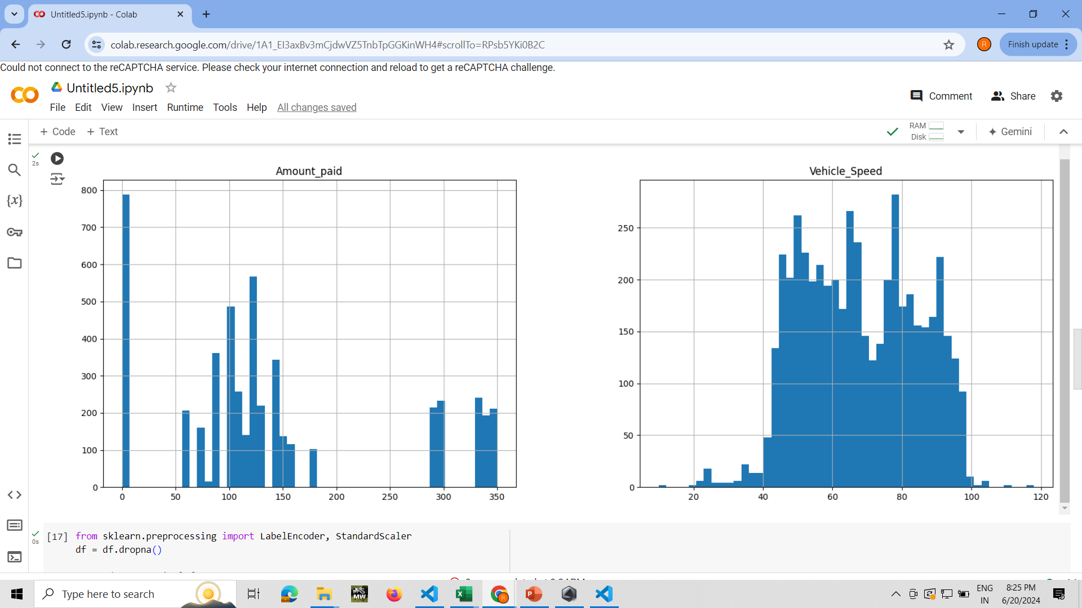

Slide 9
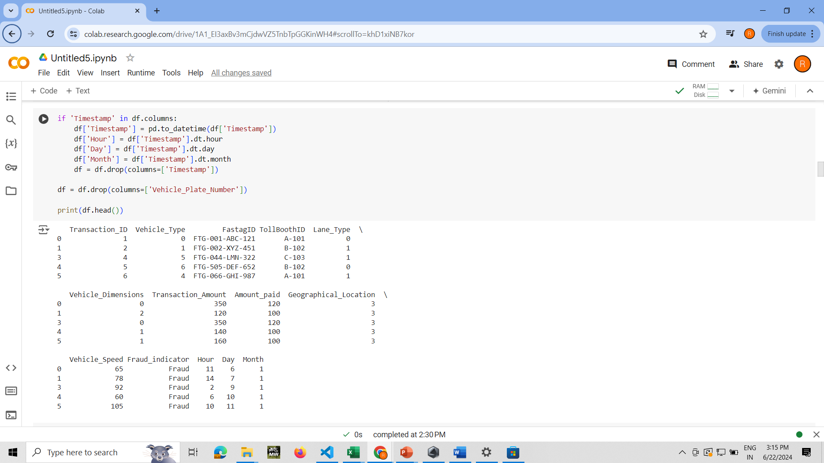
Now for the timestamp and headings we code

Slide 10
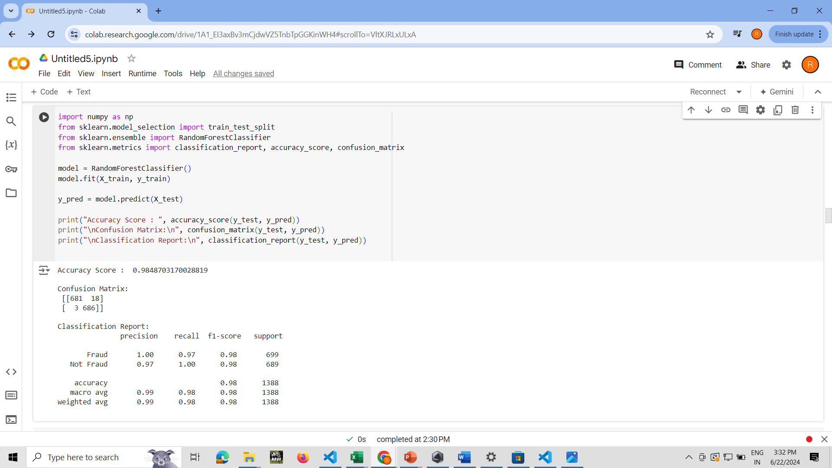
For the categorical count which shows fraud and not fraud along with the classification report along with averages

Slide 11
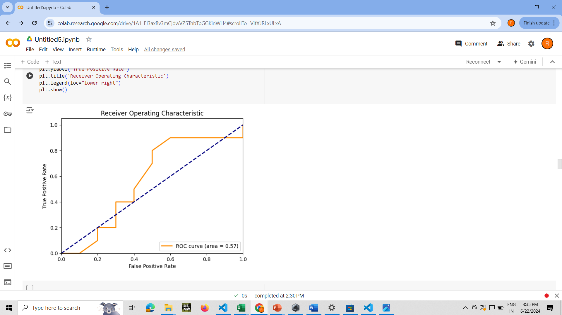
We’ll plot the ROC curve

Slide 12
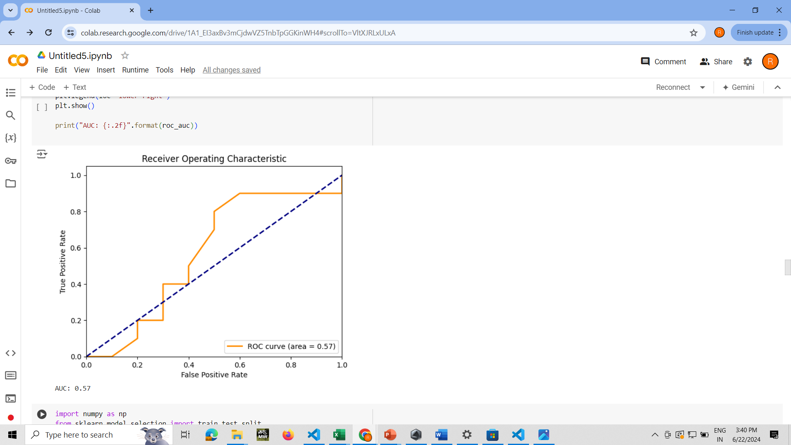
The AUC

Slide 13
ROC (Receiver Operating Characteristic) Curve:
The ROC curve is a graphical representation that shows the performance of a binary classification model at various threshold settings.
It plots the True Positive Rate (TPR, also known as Recall or Sensitivity) against the False Positive Rate (FPR) at different classification thresholds.
The ROC curve helps to understand how well the model can distinguish between the two classes (positive and negative).
AUC (Area Under the Curve):
The AUC is a single scalar value that summarizes the overall performance of a classification model.
It represents the area under the ROC curve.
AUC provides an aggregate measure of performance across all possible classification thresholds.
An AUC value ranges from 0 to 1, where 1 indicates a perfect model, 0.5 indicates a model with no discriminative power (equivalent to random guessing), and 0 indicates a perfectly wrong model.

Slide 14
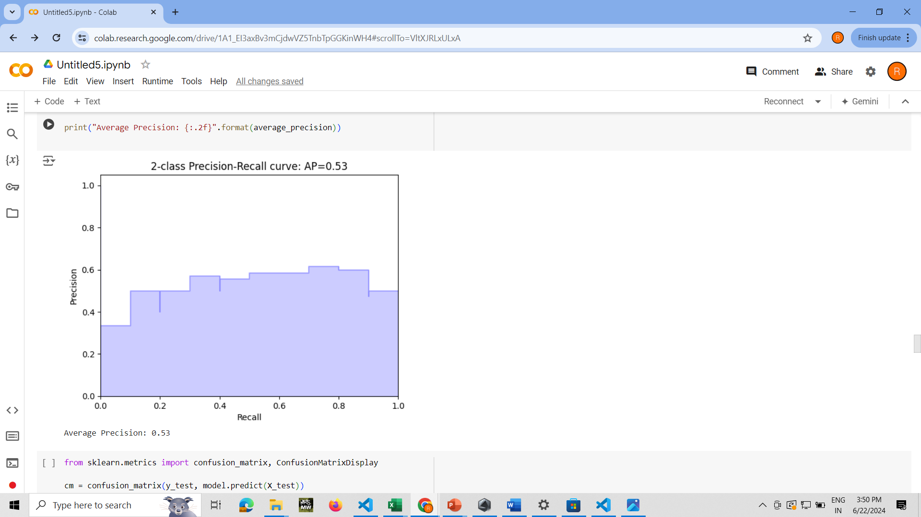
The 2-class Precision Recall Curve with the average precision

Slide 15
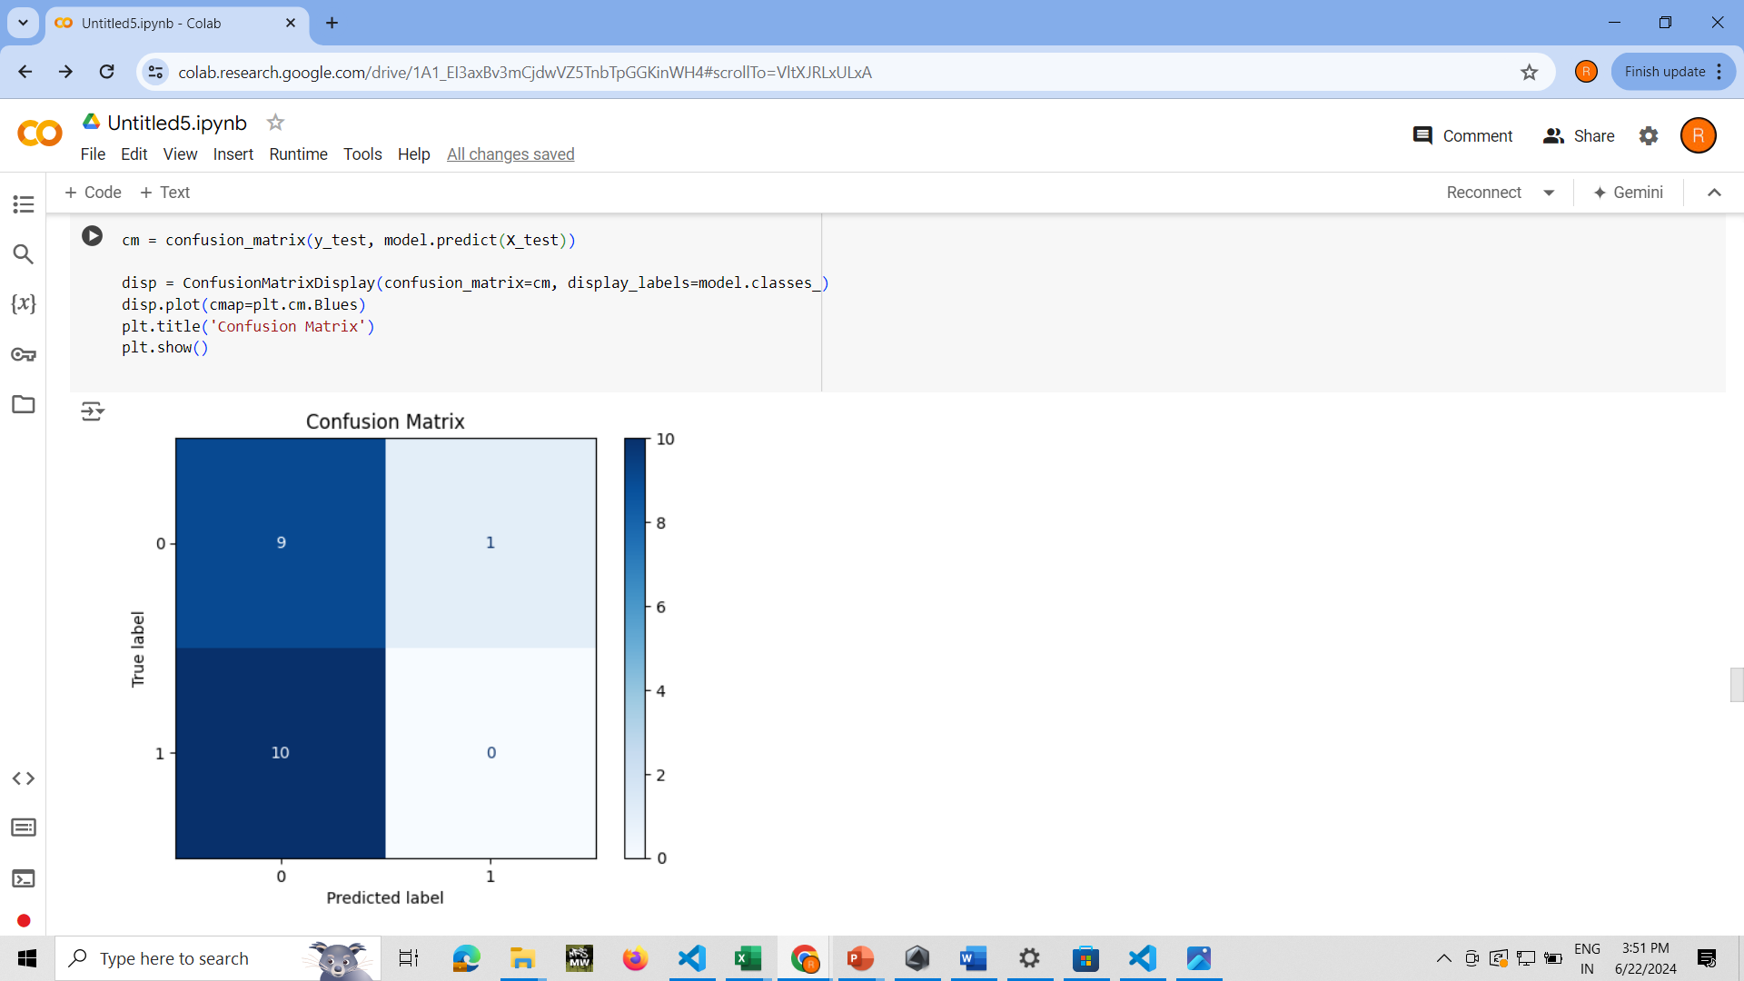
The Confusion Matrix

Slide 16
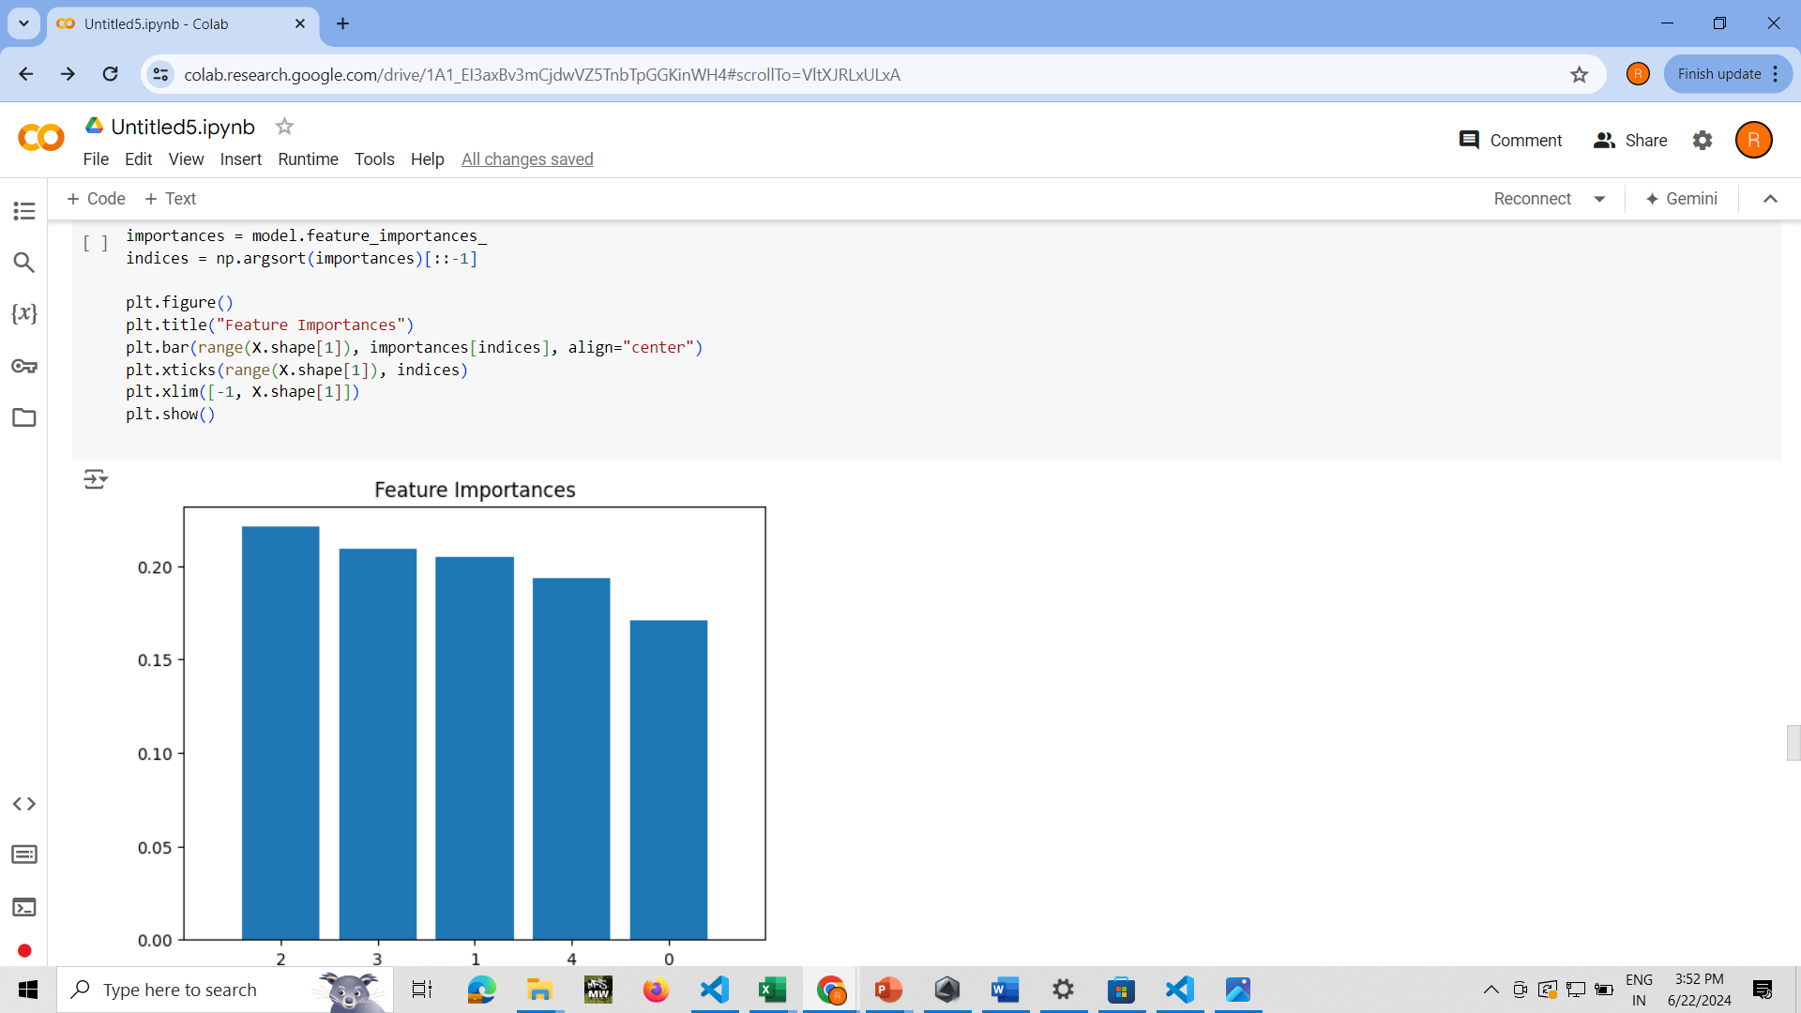
Now the Feature Importance Graph

Slide 17
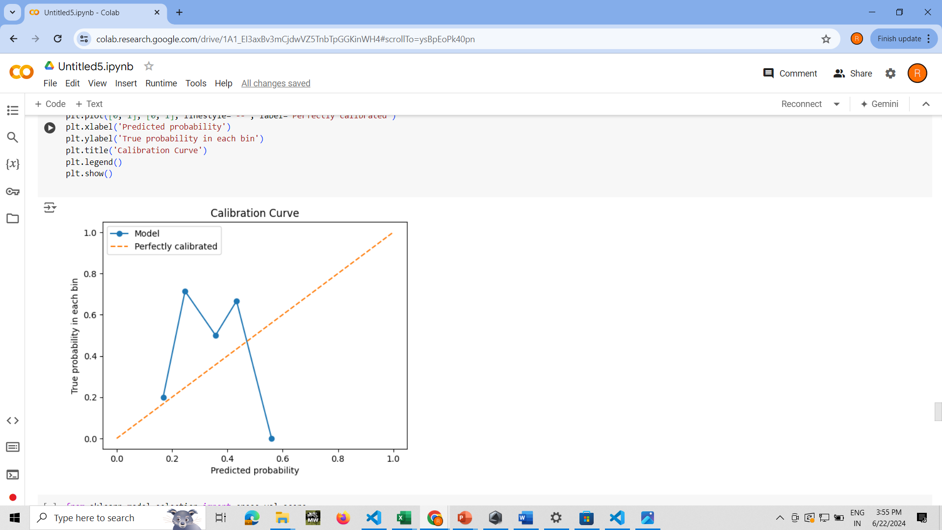
The Calibration Curve

Slide 18
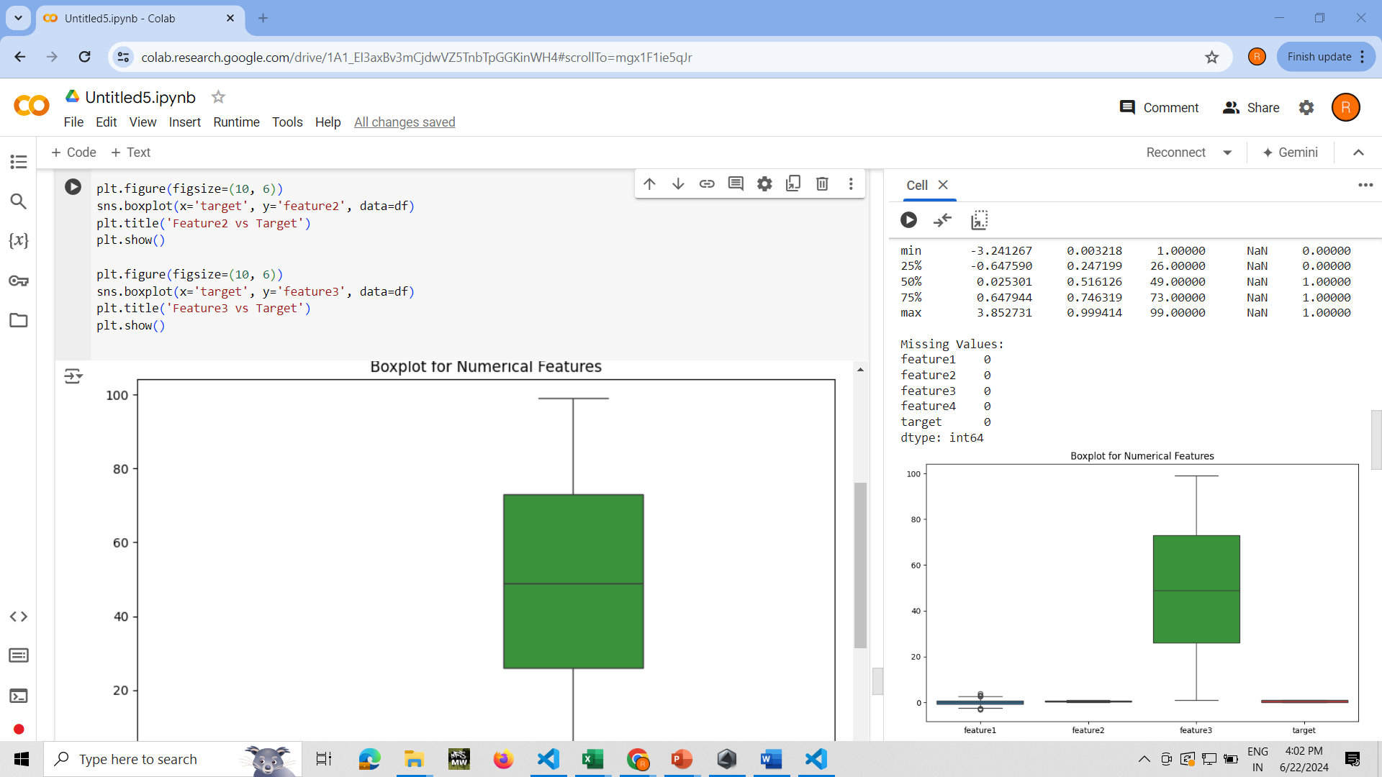
Boxplot

Slide 19
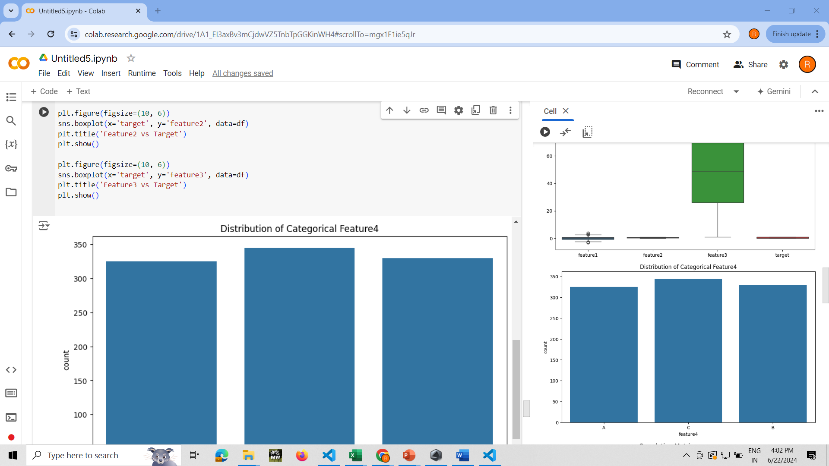
Distribution of Categorical Data

Slide 20
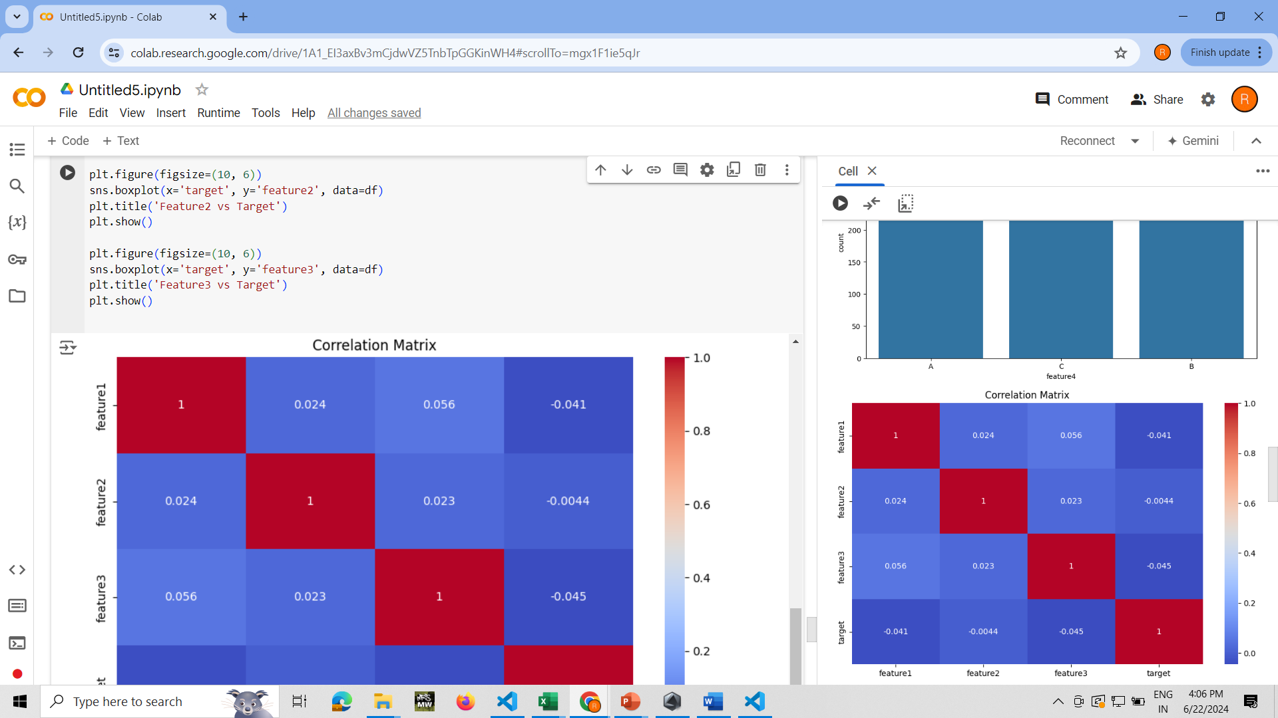
Correlation Matrix

Slide 21
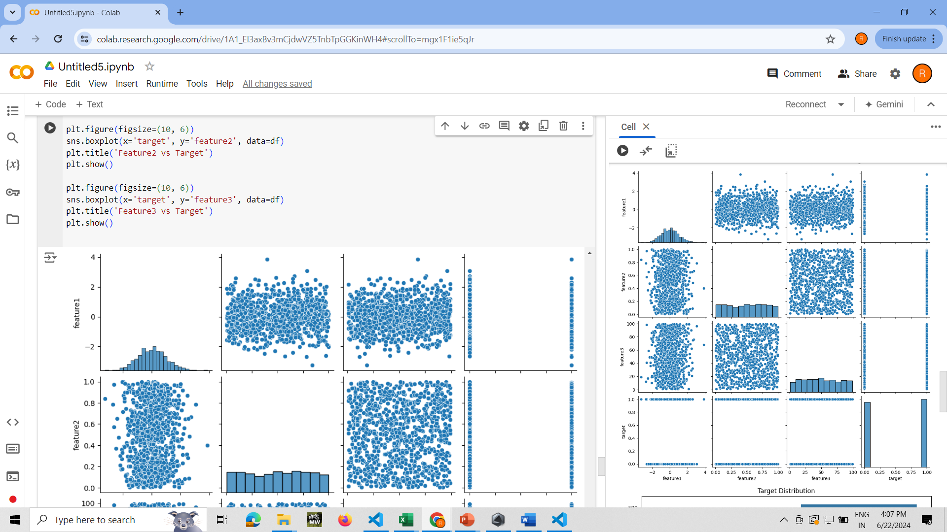
Graph comparison of all features

Slide 22
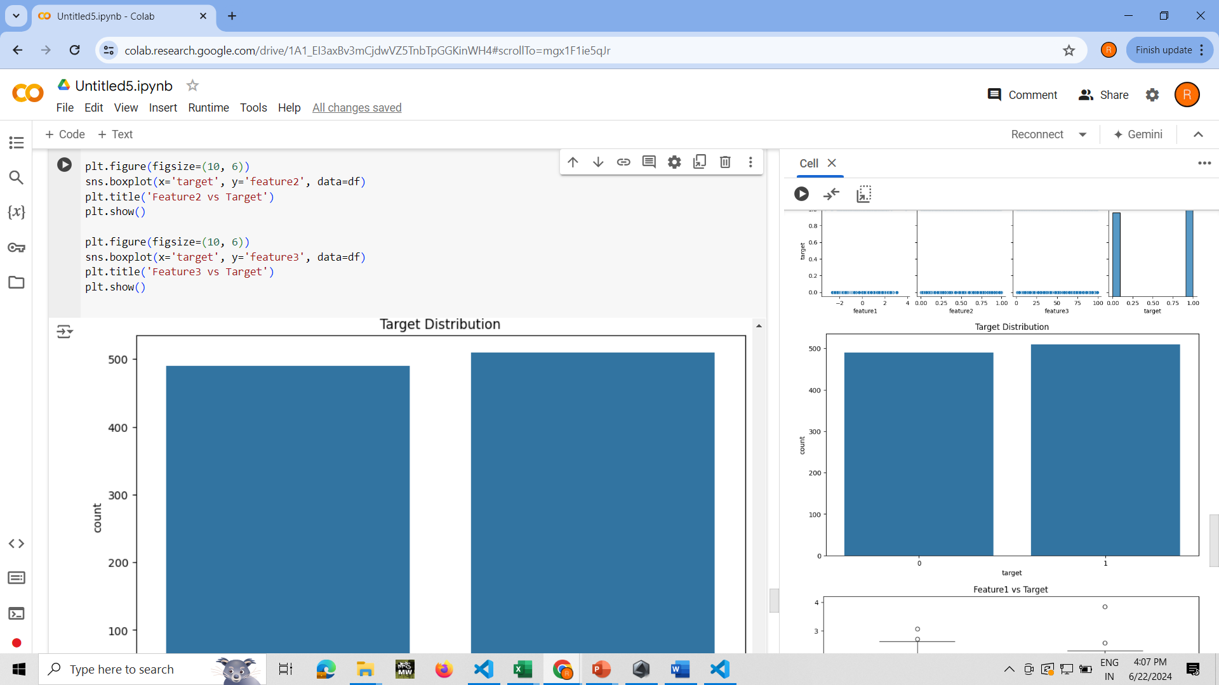
Target Distribution

Slide 23
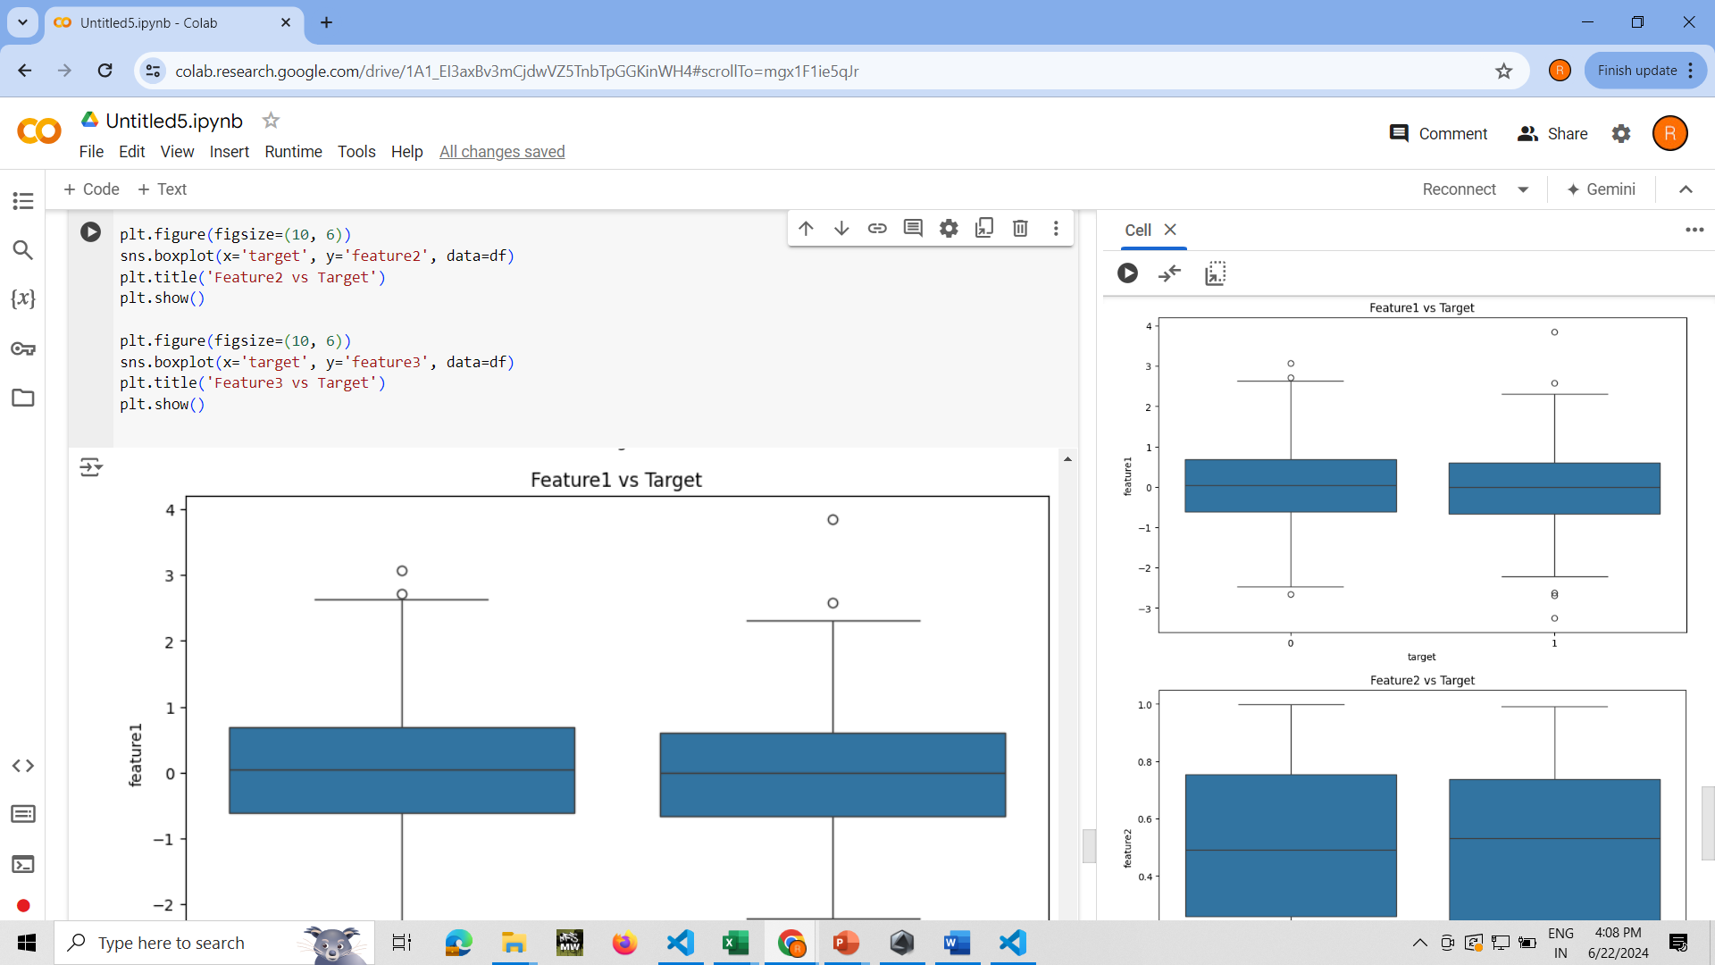
Feature 1 vs Target

Slide 24
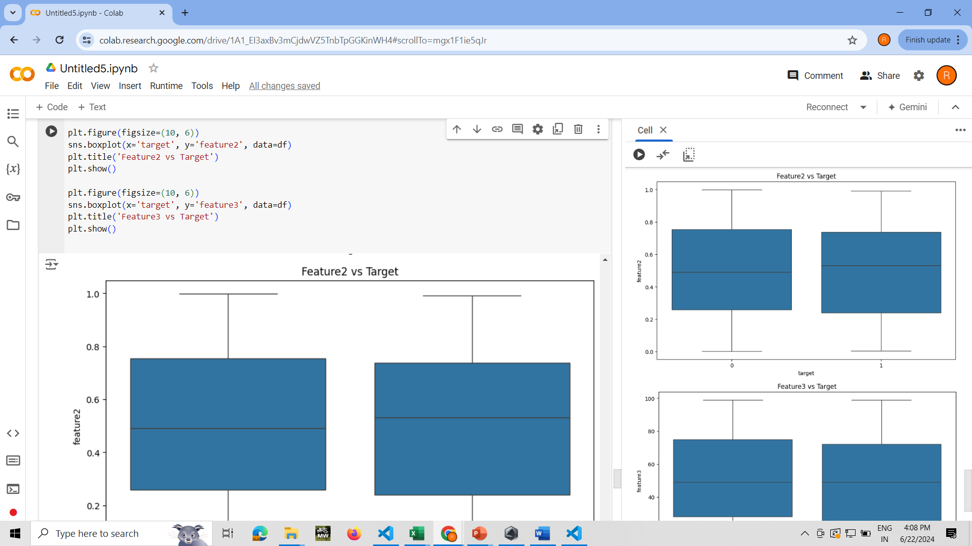
Feature 2 vs Target

Slide 25
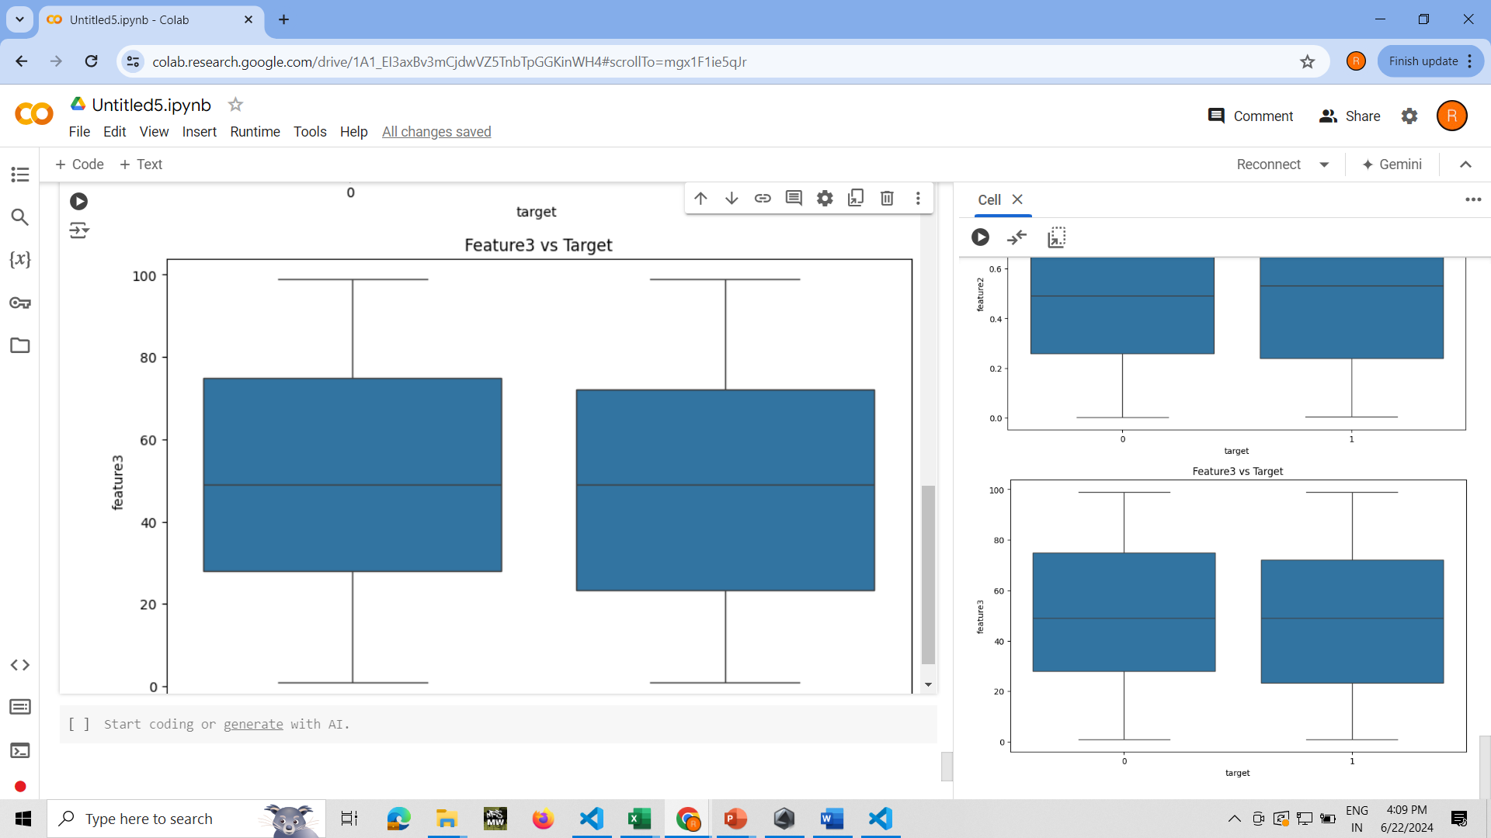
Feature 3 vs Target

Slide 26
THANK YOU

